Slide 1

Projection Visual Acuity Chart Calibration Settings
4th Semester M.C.A.
Mid-Term Project Presentation
By
Punith Bandodekar
(Registration Number: 140970027)
Under the guidance of
Mrs. Archana H. Mr. Adithya C and Mr. Nagarajan T
Assistant Professor-Senior scale Research Scholar, Research Assistant
Department of Computer Applications Department Of Optometry
M.I.T, Manipal - 576 104 SOAHS, Manipal - 576 104
Department of Computer Applications, MIT, Manipal

Slide 2
Presentation Outline
Introduction
Existing system
Proposed System
Objectives
Hardware Software Requirements
Modules
Product Functionality
Screen Shots
Future Work
Conclusion
Bibliography
Department of Computer Applications, MIT, Manipal
1

Slide 3
Introduction
Projection visual acuity chart is an android application developed for vision testing using an android smartphone or a tablet and a portable projector
Different charts are displayed using the projector such as Snellen, LogMar, Landolt C, Tumbling E, Sloan
The vision testing is based on what characters the patients are able to see on the displayed chart
Department of Computer Applications, MIT, Manipal
2

Slide 4
Existing System
The current system is a computerized version of the eye diagnosis application for windows
It is less user friendly with poor UI design
It is not easily portable
Charts are displayed using a computer monitor
Department of Computer Applications, MIT, Manipal
3

Slide 5
Proposed System
Proposed system is an android application which performs vision testing using a smartphone and a mini projector
Designing graphically user friendly interface
Department of Computer Applications, MIT, Manipal
4

Slide 6
Objectives
To display the character with respect to the distance between the projector and the projected screen
To create simple and user friendly interface
To store different chart settings using shared preferences.
Charts are visualized through a mini projector which is portable.
Department of Computer Applications, MIT, Manipal
5

Slide 7
Requirements for development
SOFTWARE REQUIREMENTS
2 GB RAM and above
400 MB hard disk space
Intel Pentium 3 processor or higher
HARDWARE REQUIREMENTS
Microsoft Windows 8/7/Vista
At least 1 GB for Android SDK, emulator system images and caches
Java Development Kit (JDK) 7
Department of Computer Applications, MIT, Manipal
6

Slide 8
Requirements for deployment
Android- 4.0 and above
Screen size for Android devices- 5’ and above
DLP3010 Light Crafter Mini Projector
Department of Computer Applications, MIT, Manipal
7

Slide 9
Modules
Calibration Module: Here we adjust the height and width of the character displayed on the projected screen
Visualizing Charts: This module exhibits the selected chart for patient’s vision testing. The visualization displays different types of charts such as Snellens, Logmar, Landolt C and Sloan charts
Department of Computer Applications, MIT, Manipal
8

Slide 10
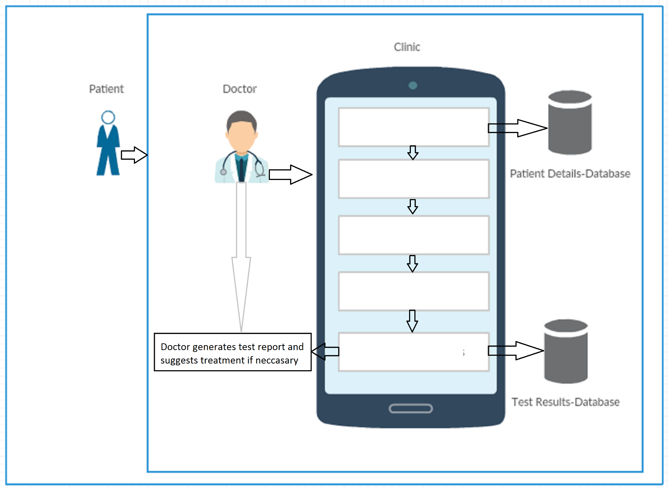
Product Functionality
Patient Details
Calibration
Chart Settings
Display Chart
Display Test Results
Figure 1: Product Functionality
Department of Computer Applications, MIT, Manipal
9

Slide 11
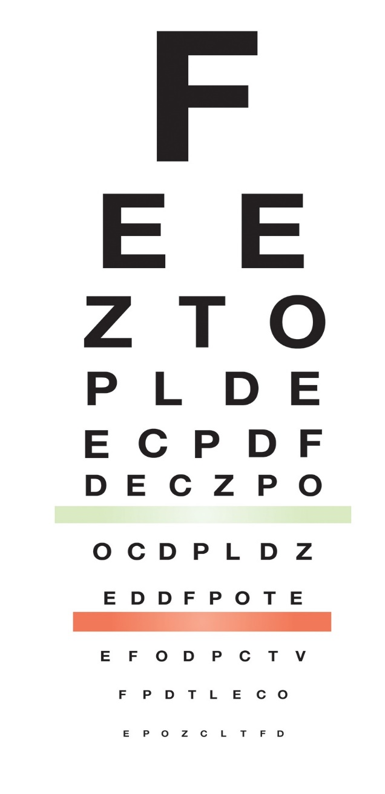
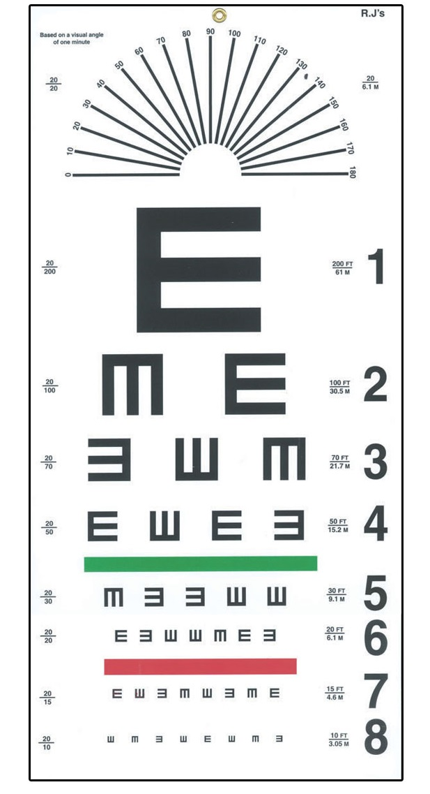

Charts
Figure 2: Snellen
Figure 3: Tumbling E
Figure 4: Landolt C
Department of Computer Applications, MIT, Manipal
10

Slide 12
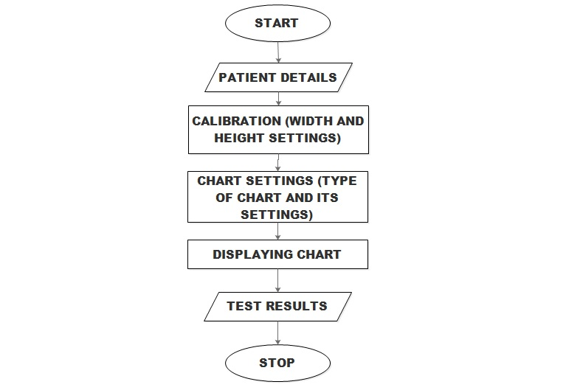
Flow Diagram
Figure 5: Flow Diagram
Department of Computer Applications, MIT, Manipal
11

Slide 13
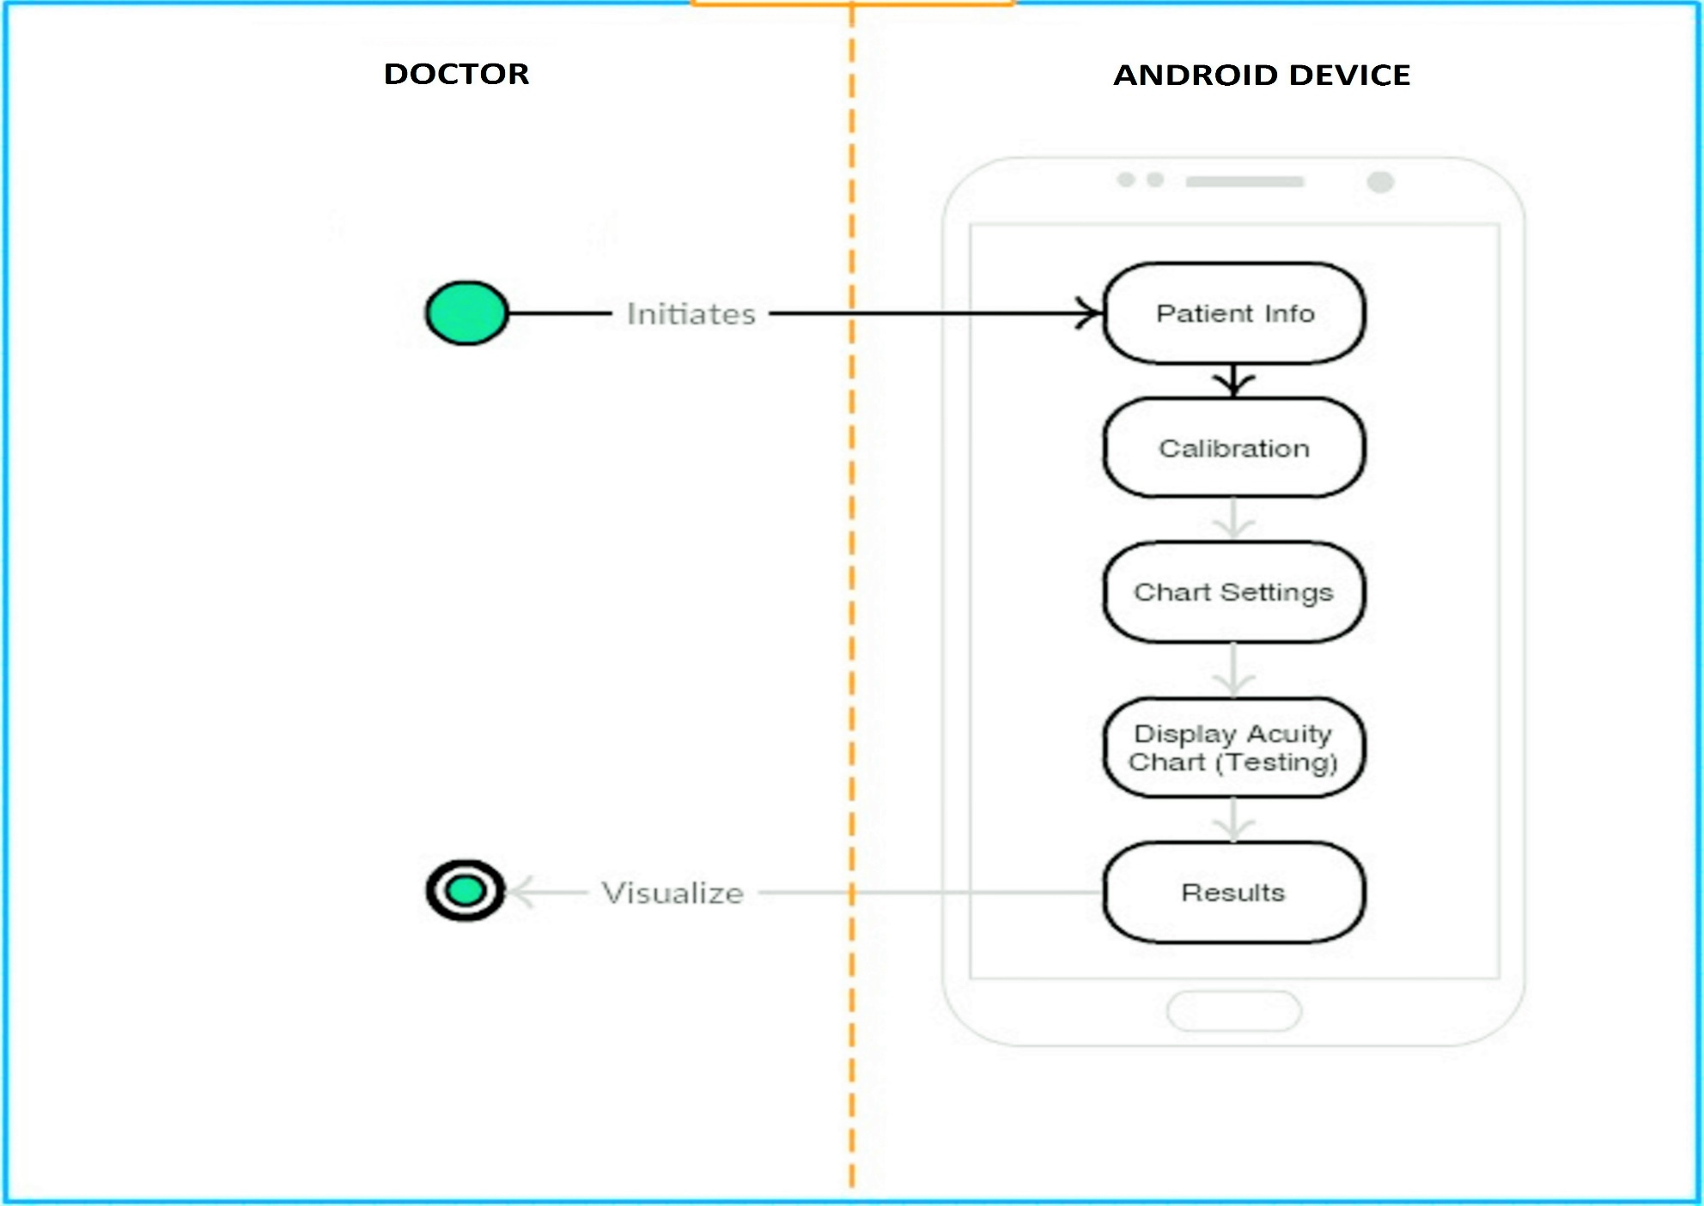
Activity Diagram
Figure 6: Activity Diagram
Department of Computer Applications, MIT, Manipal
12

Slide 14
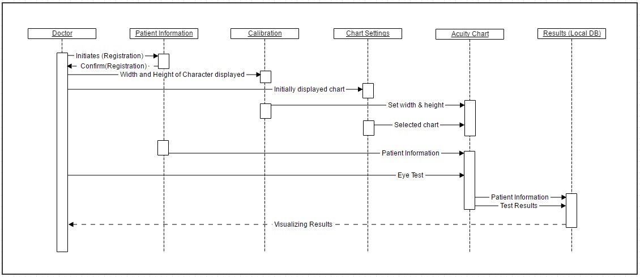
Sequence Diagram
Figure 7: Sequence Diagram

Slide 15
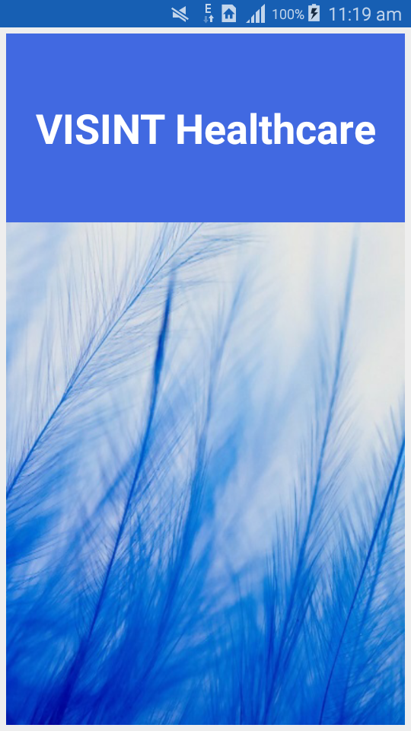
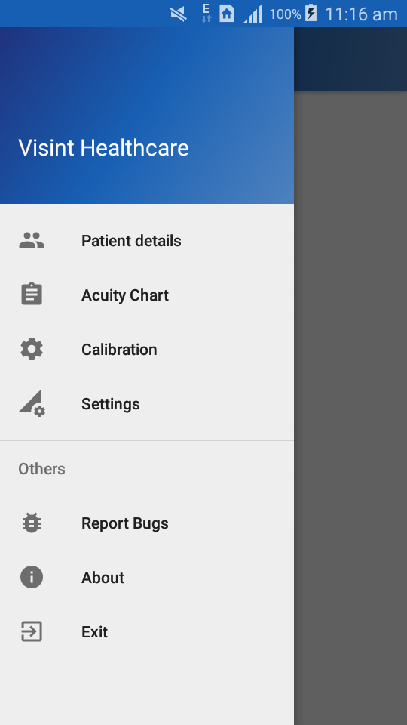
Screenshots
Figure 8: Splash Screen
Figure 9: Navigation Drawer
Department of Computer Applications, MIT, Manipal
14

Slide 16
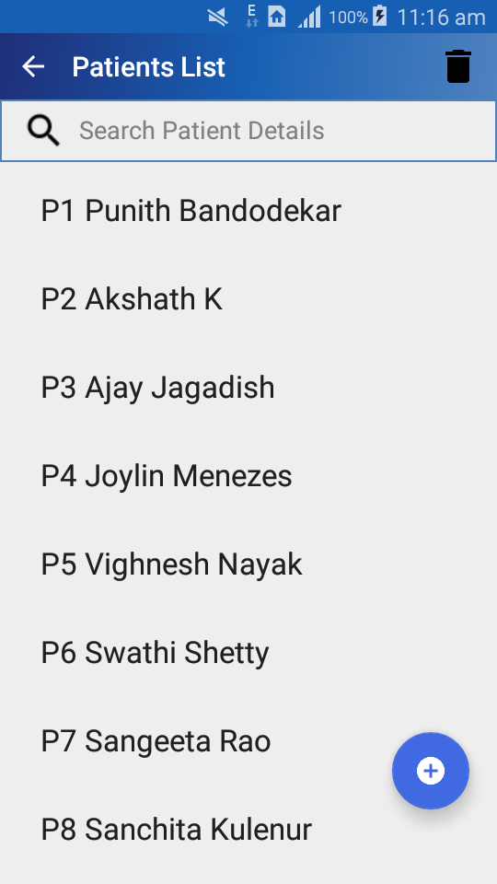
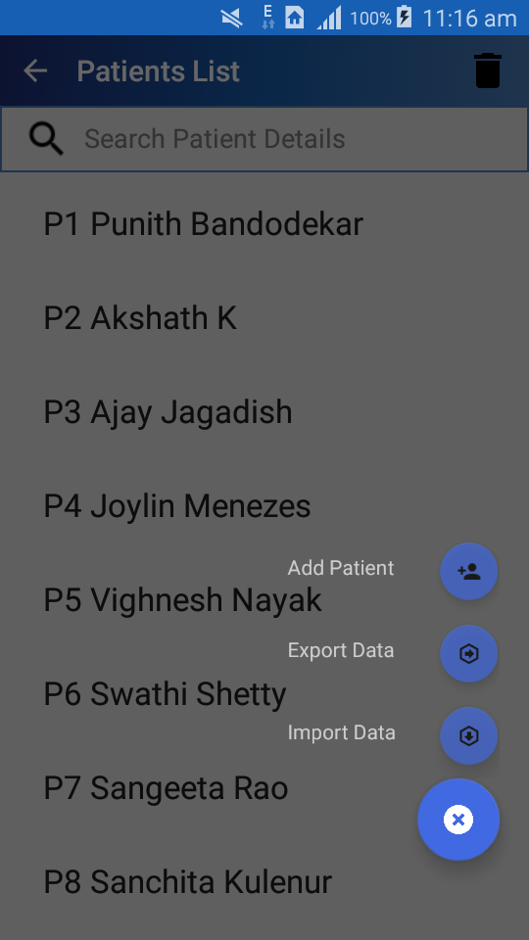
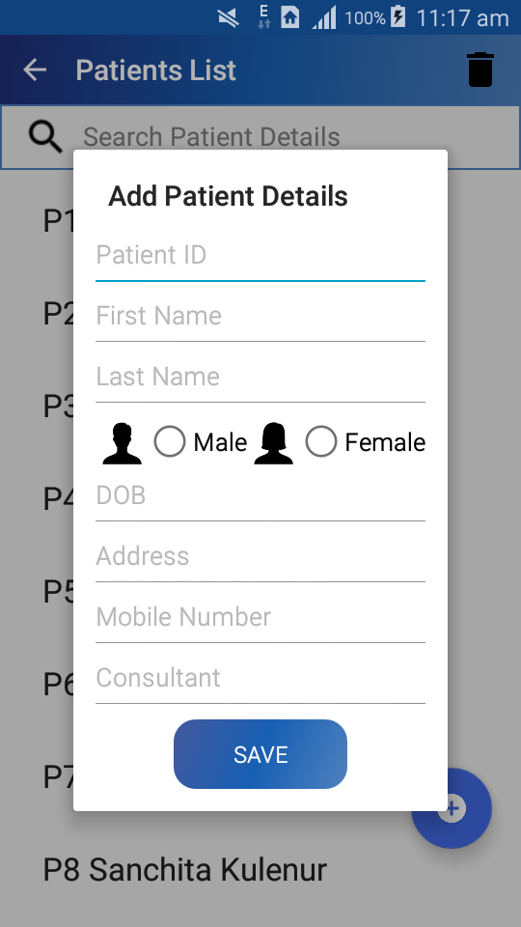
Screenshots
Figure 10: Patient List
Figure 11: Add Patient Details
Department of Computer Applications, MIT, Manipal
15

Slide 17
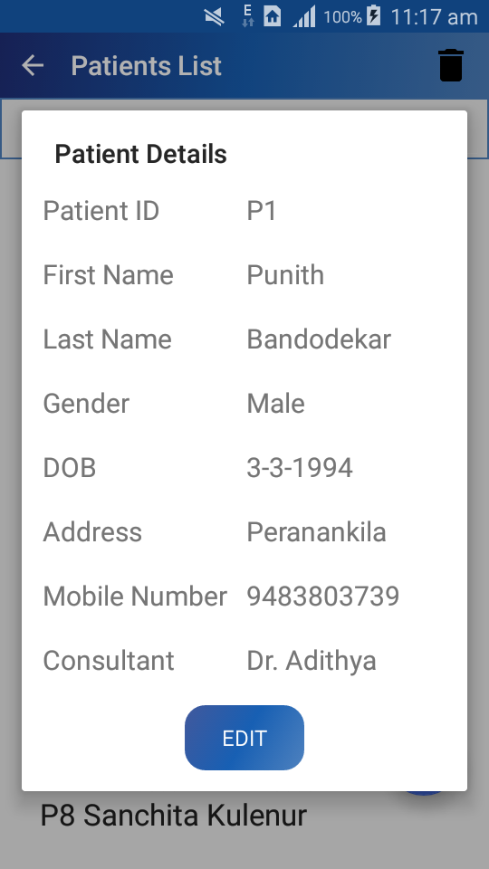
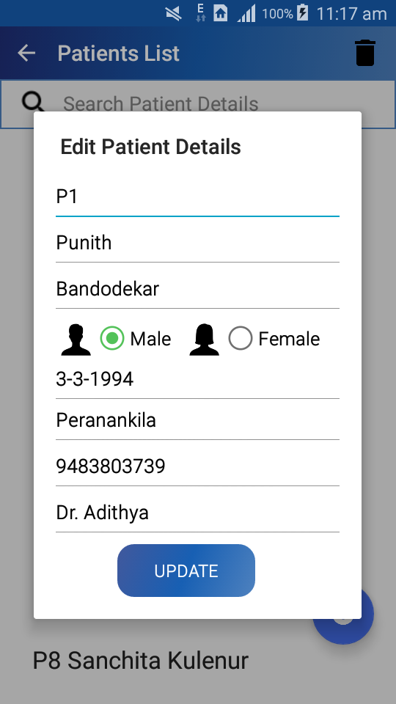
Screenshots
Figure 12: Edit Patient Details
Department of Computer Applications, MIT, Manipal
16

Slide 18
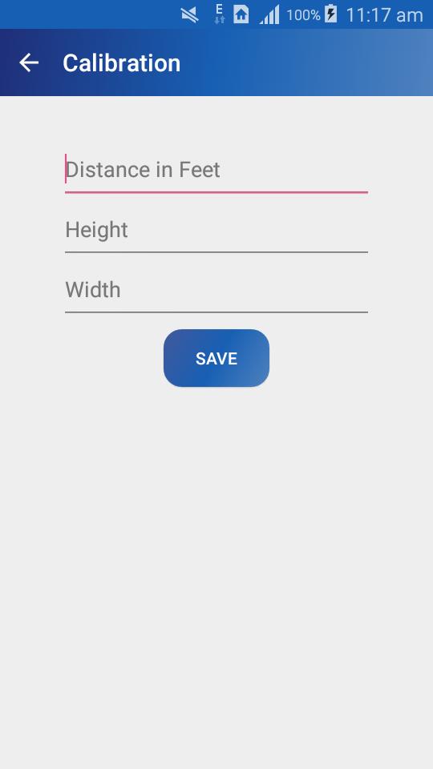
Screenshots
Figure 13: Calibration
Department of Computer Applications, MIT, Manipal
17

Slide 19
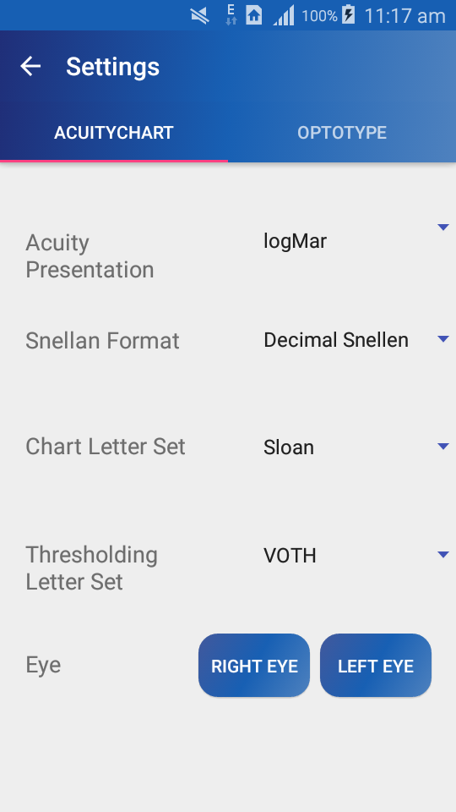
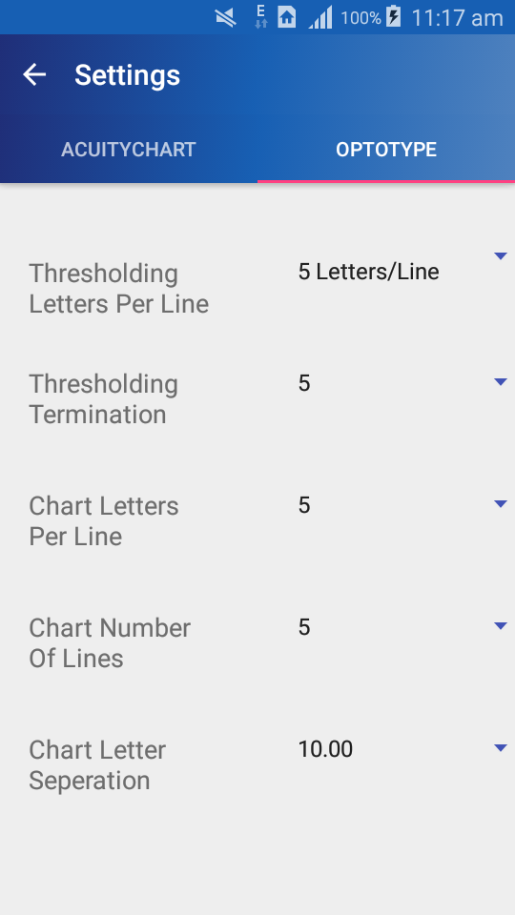
Screenshots
Figure 14: Chart Settings
Department of Computer Applications, MIT, Manipal
18

Slide 20
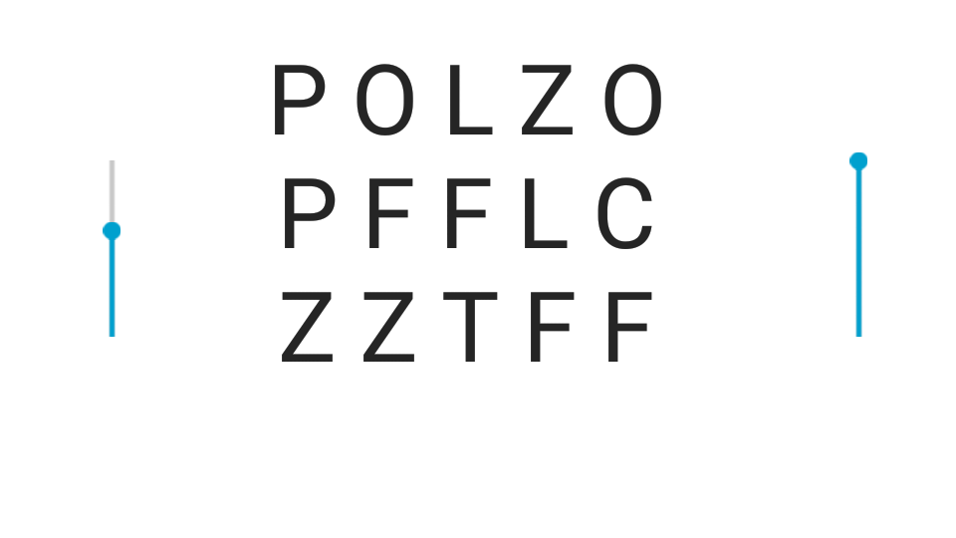
Screenshots
Figure 15: Displaying Chart
Department of Computer Applications, MIT, Manipal
19

Slide 21
Work Done So Far
Number of Weeks | Work Done | Remark
1 - 3 | Android Training, Installation | Completed
4 | Project Requirements, Synopsis, Android Training | Completed
5 | Worked on Navigation Drawer, Floating Action Button | Completed
6 | Worked on SQLite Database, List view and Fragments | Completed
7 | Calibration Module, Implementation of gesture detection | Completed
8 | Working on Seek bar, Shared Preferences and Acuity chart | Ongoing
Department of Computer Applications, MIT, Manipal
20

Slide 22
Work To Be Done
Number of Weeks | To Be Done
4 | Digitizing the chart
2 | Results Module
2 | Testing, Report and Documentation
Department of Computer Applications, MIT, Manipal
21

Slide 23
Conclusion
Improved my knowledge on how a vision testing is performed.
Learnt how to display characters with different sizes on an android platform.
Got to know the working of the portable mini projector connected to an android mobile.
Department of Computer Applications, MIT, Manipal
22

Slide 24
Bibliography
www.tutorialspoint.com/android [Last visited 13/03/2016]
www.developer.android.com [Last visited 29/03/2016]
www.stackoverflow.com [Last visited 02/04/2016]
www.androidhive.com [Last visited 27/03/2016]
Department of Computer Applications, MIT, Manipal
23

Slide 25
THANK YOU

